Slide 1
SV ROS – Introduction to ROS
This course will use a Raspberry PI 3 to learn ROS, the Robot Operating System developed by Willow Garage. ROS is an Open Source software, supported by OSRF. In this section we prepare the Pi and load ROS. In the next session we will actually use ROS to control a robot platform based on a Neato Botvac

Slide 2
SV ROS – Introduction to ROS
The goal for this session is to get ROS working on both your laptop and the Raspberry PI 3. This means gaining familiarity with Ubuntu on the laptop first, and then on the PI. By the end of the day you should have two ROS systems for practicing ROS. In the next session we will pair your PI onto a working robot.

Slide 3
SV ROS – Introduction to ROS
Raspberry Pi 3 – Arm based Linux
Ubuntu Mate 16.04 – ROS Kinetic
16 g SD card
For bringing up at home – USB keyb.
HD TV, Ethernet (WiFi OK)
USB power for PI
Install Mate
Install ROS
Install ROS Nodes in Catkin WS

Slide 4
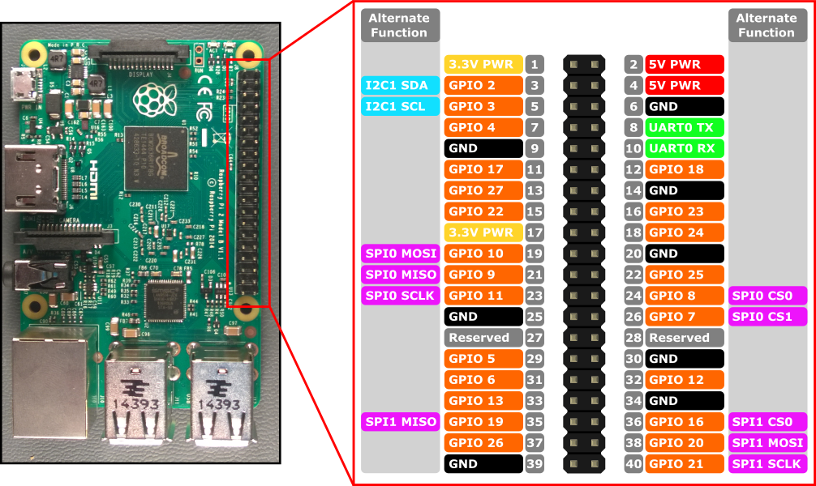
RPi3 pinouts

Slide 5
SV ROS – Introduction to ROS
https://ubuntu-mate.org/download/
Expand 8g image to 16 (graphical)
Set up WiFi Network Manager
sudo apt-get update
sudo apt-get upgrade
Sometimes: sudo dpkg –configure –a
rpi-update -- upgrades firmware
raspi-config enable camera, i2c

Slide 6
SV ROS – Introduction to ROS
Unix Commands
cd cd cd / cd ..
rm rm * rm –rf
mkdir
ps –eaf | grep ros
history|grep apt-get
vi cat sort scripts

Slide 7
SV ROS – Introduction to ROS
ROS Kinetic Install
sudo sh -c 'echo "deb http://packages.ros.org/ros/ubuntu $(lsb_release -sc) main" > /etc/apt/sources.list.d/ros-latest.list'
sudo apt-key adv --keyserver hkp://ha.pool.sks-keyservers.net:80 --recv-key 0xB01FA116
sudo apt-get update
sudo apt-get install ros-kinetic-desktop-full

Slide 8
SV ROS – Introduction to ROS
sudo rosdep init
rosdep update
echo "source /opt/ros/kinetic/setup.bash" >> ~/.bashrc
source ~/.bashrc
sudo apt-get install python-rosinstall (utilities like git, hg)

Slide 9
SV ROS – Introduction to ROS
mkdir -p ~/catkin_ws/src
cd ~/catkin_ws/src
catkin_init_workspace
cd ..
catkin_make
And then edit .bashrc to change the source /opt/ros/kinetic/setup.bash to
~/catkin_ws/devel/setup.bash also it helps to add the following line if the
Pi is hosting the robot:
export ROS_MASTER_URI=http://$HOSTNAME.local:11311

Slide 10
SV ROS – Introduction to ROS
Next - edit hostname and hosts files
Add catkin nodes
RBX1, intro_to_ros

Slide 11
SV ROS – Introduction to ROS
Test roscd, roscore
Launch nodes, fix dependency errors with rosdep install from sources, get working and trouble shoot.
rosdep install --from-paths ~/catkin_ws/src --ignore-src --rosdistro=kinetic -y
Common problems permissions on serial devices /dev/ttyUSB0 or /dev/ttyACM0 – may need persistent rules.

Slide 12
SV ROS – Introduction to ROS
https://github.com/pirobot/rbx1
https://github.com/SV-ROS/intro_to_ros

Slide 13
Configuring wifi from the command line:
nmcli dev wifi list
sudo nmcli dev wifi con "ssid" password *******
(if needed - unusual)
sudo nmcli con add con-name "ssid" ifname wlan0 type wifi ssid " "
sudo nmcli con modify "ssid" wifi-sec.key-mgmt wpa-psk
sudo nmcli con modify "ssid" wifi-sec.psk ********

Slide 14
Exercise 1 (Ubuntu newbies pair with experts)
Configure network on laptop(via desktop Network Manager) or via nmcli
Log onto laptop and get to a terminal window(ctrl-alt-T) or exit GUI via ctrl-alt-F3
Practice cd, ls, rm, vi, ps, history
Check to see if ROS is installed on laptop.
Install kinetic-desktop

Slide 15
also
Excercise 2 Working with ROS
Check roscd to find teleop_twist_keyboard
Install if missing
Use the Internet to find and install ros by example if it isn’t already in your catkin_ws/src
Also find and install arbotix_ros
https://github.com/vanadiumlabs/arbotix_ros.git
catkin_make - and fix dependencies

Slide 16
Excercise 3 Running a fake robot on your laptop
Open up 3 terminal windows
Rosrun rbx1_bringup fake_turtlebot.launch
Rosrun rviz rviz
Rosrun teleop<tab> t<tab>
If any failed fix missing dependencies, missing nodes (controller-msgs) in arbotix
Have fun and explore other programs.

Slide 17
Exercise 4 the RPI
Now that we have ros running on the laptop, we need to get ros working on the PI.
We need to configure the hostname and network on the pi, and this might take some time and patience.
Ssh from laptop to your Pi.

Slide 18
Exercise 5
Install arbotix/rbx1 on Pi
Ssh into pi from laptop
Start fake_turtlebot on pi
Open two more windows on laptop
Export ROS_MASTER_URI and ROS_IP
Open rviz and teleop
Drive fake robot remotely/

